Slide 1
Module 5 – Network Layer IP Addressing
Jayavignesh
Asst Professor
SENSE

Slide 2
OUTLINE
Functionalities of Network Layer
Internet Protocol
IPv4 Addressing (Logical, Global, Unique, Hierarchical)
Address Space, Notations
Classful Addressing
Subnetting
Classless Addressing
Network Address Translation (NAT)

Slide 3
Functions of Network Layer
Source to Destination Delivery of Datagrams via multiple networks. (Host To Host Communication)
Internet Protocol (IP)
Connectionless protocol
Relaying datagrams across network boundaries. (Internetworking).
Host Addressing to identify device
Biggest Challenges
Addressing: where should information be directed to?
Routing: what path should be used to get information there?

Slide 4
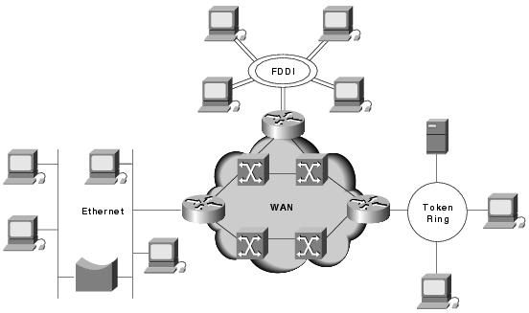

Slide 5
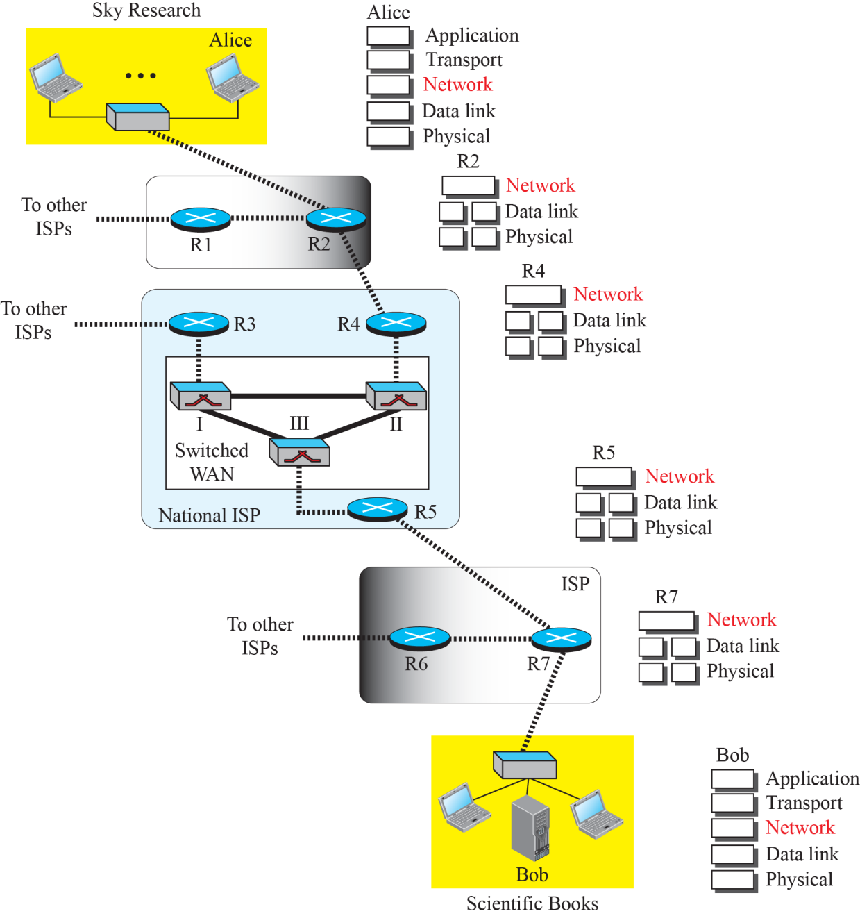
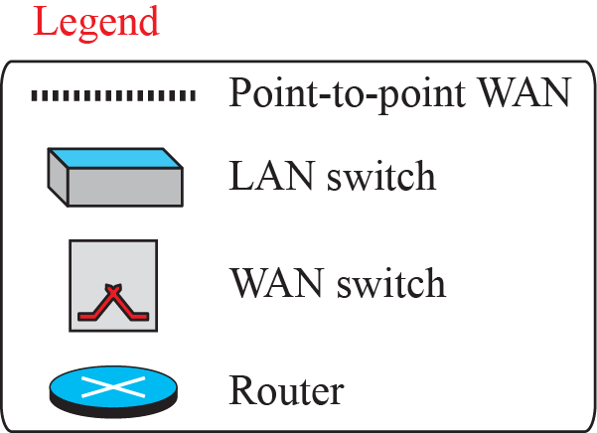
Figure 18.1: Communication at the network layer

Slide 6
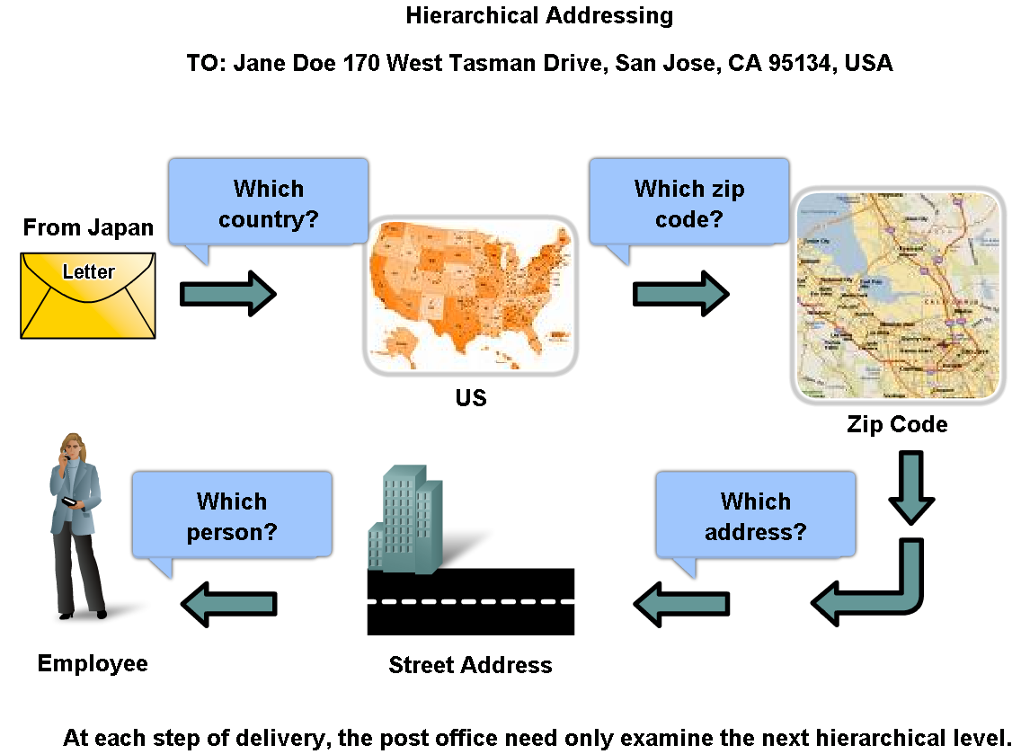
Hierarchical Addressing

Slide 7
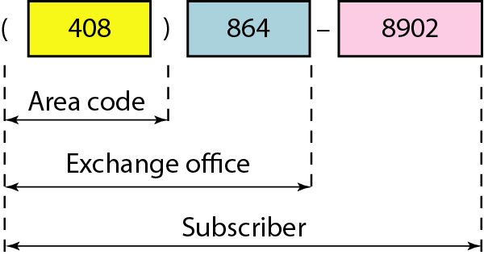
Levels of hierarchy in Telephone Numbering
Hierarchical addressing solves the problem of devices communicating across networks of networks

Slide 8
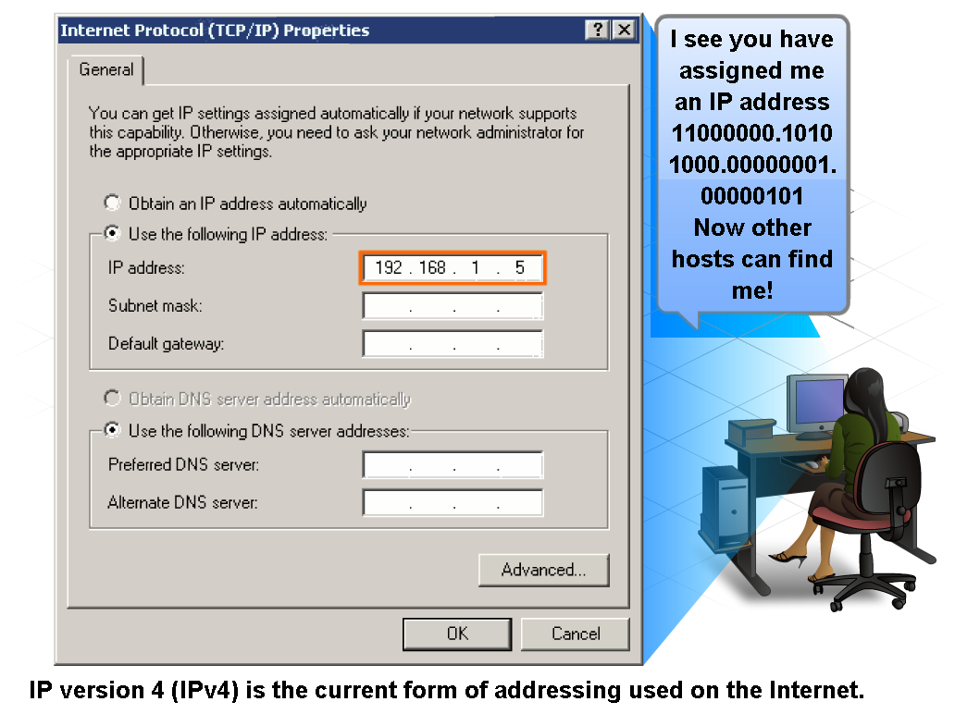
IP Addressing Structure
Dotted decimal structure of a binary IP address

Slide 9

Note
An IPv4 address is 32 bits long.
Uniquely and universally defines the connection of a device (for example, a computer or a router) to the Internet.

Slide 10
Note
Unique – Each address defines one & only one connection to Internet
* 2 devices can never have same address at same time *
* Address may be assigned to a device for a time period and then taken away and assigned to another device *

Slide 11
Note
The address space of IPv4 is 2³² or 4,294,967,296.

Slide 12

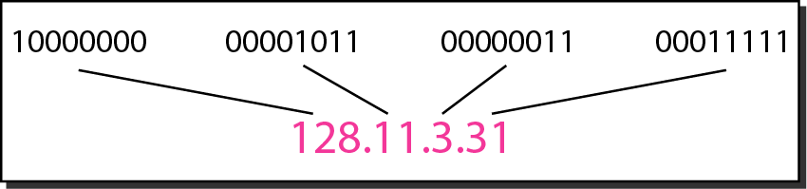


Figure 19.1 Dotted-decimal notation and binary notation for an IPv4 address

Slide 13
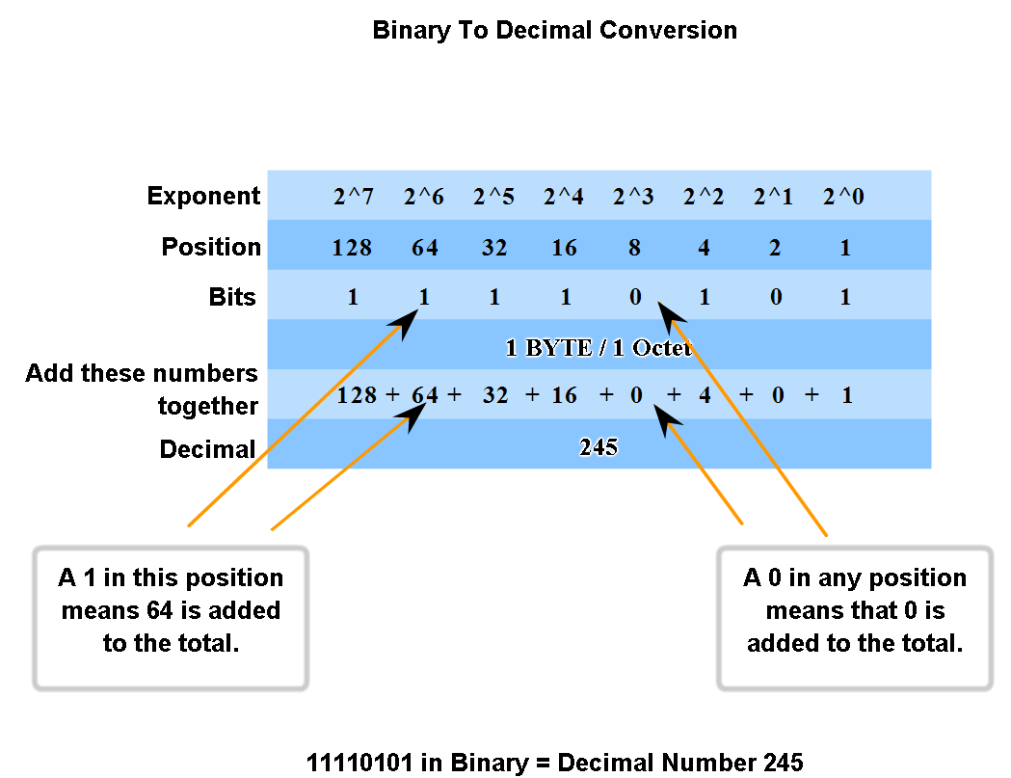
IP Addressing Structure

Slide 14
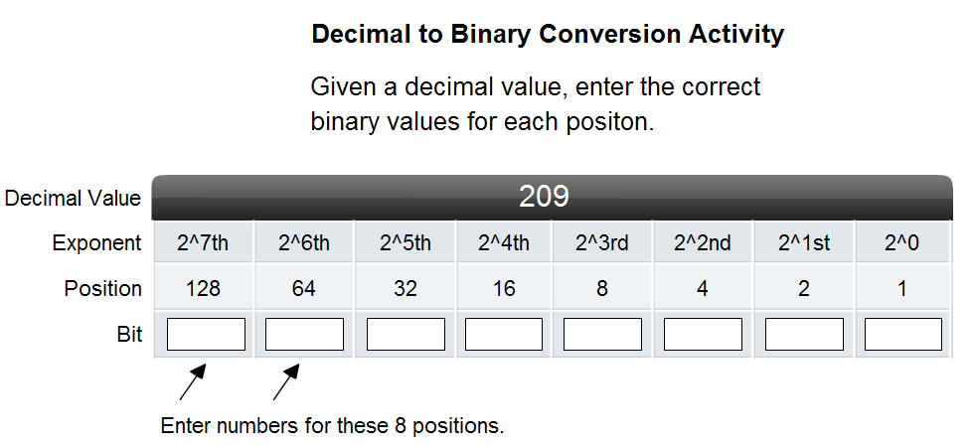
IP Addressing Structure

Slide 15
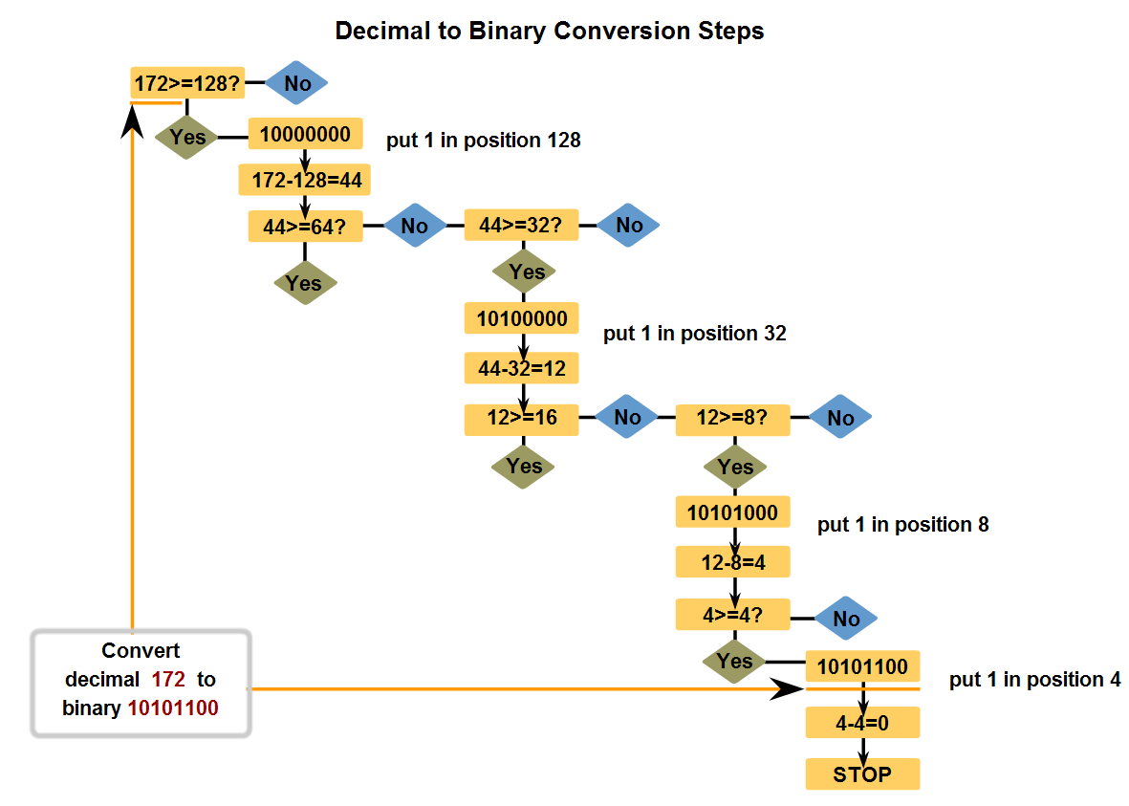
IP Addressing Structure
Convert decimal to 8-bit binary

Slide 16
Example 19.1
Change the following IPv4 addresses from binary notation to dotted-decimal notation.
Solution
We replace each group of 8 bits with its equivalent decimal number and add dots for separation.

Slide 17
Example 19.2
Change the following IPv4 addresses from dotted-decimal notation to binary notation.
Solution
We replace each decimal number with its binary equivalent

Slide 18
Example 19.3
Find the error, if any, in the following IPv4 addresses.
Solution
a. There must be no leading zero (045).
b. There can be no more than four numbers.
c. Each number needs to be less than or equal to 255.
d. A mixture of binary notation and dotted-decimal notation is not allowed.

Slide 19
Note
In classful addressing, the address space is divided into five classes:
A, B, C, D, and E.

Slide 20
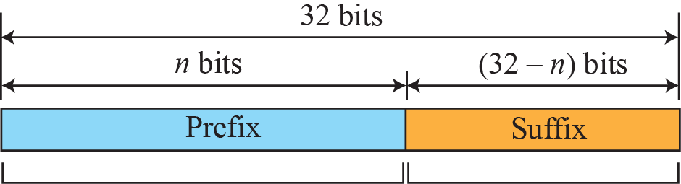
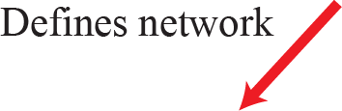

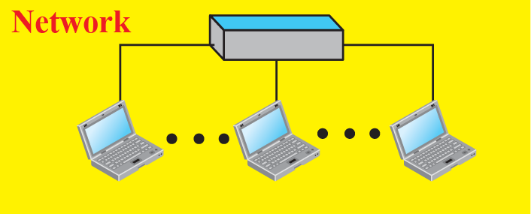
Figure 18.17: Hierarchy in addressing

Slide 21
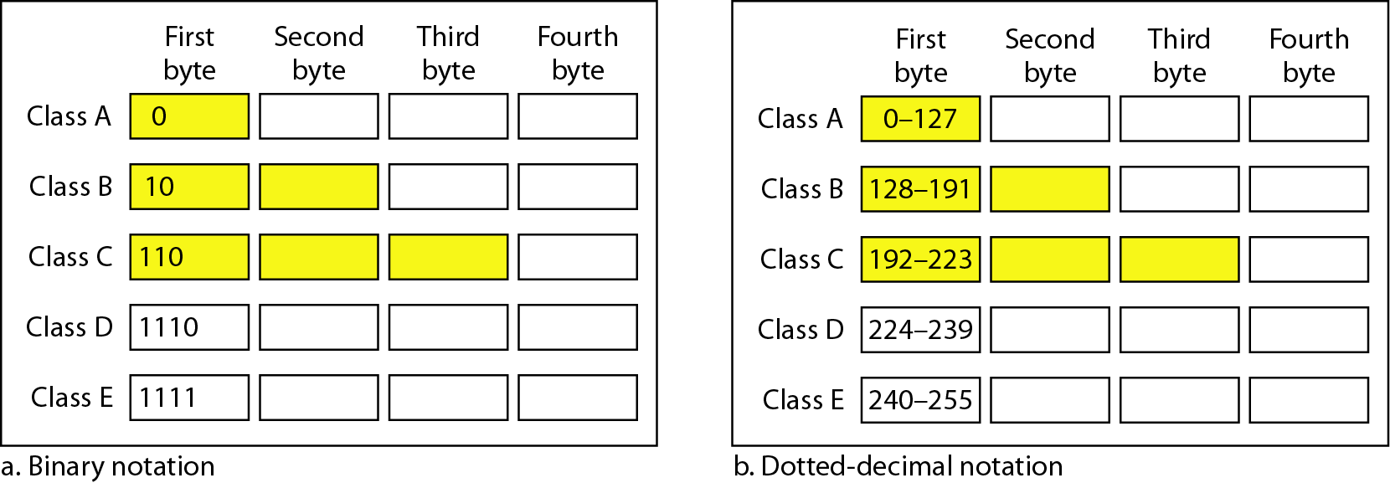
Figure 19.2 Finding the classes in binary and dotted-decimal notation

Slide 22
Figure 19.2 Finding the classes in binary and dotted-decimal notation

Slide 23
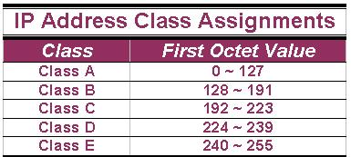
IP Address Classes (Cont.)
The 5 IP classes are split up based on the value in the 1st octet:

Slide 24
Network/Host Portions
The 32 bits of the IP address are divided into Network & Host portions, with the octets assigned as a part of one or the other.
Network & Host Representation
By IP Address Class
Class
Octet1
Octet2
Octet3
Octet4
Class A
Network
Host
Host
Host
Class B
Network
Network
Host
Host
Class C
Network
Network
Network
Host

Slide 25
Example 19.4
Find the class of each address.
a. 00000001 00001011 00001011 11101111
b. 11000001 10000011 00011011 11111111
c. 14.23.120.8
d. 252.5.15.111
Solution
a. The first bit is 0. This is a class A address.
b. The first 2 bits are 1; the third bit is 0. This is a class C address.
c. The first byte is 14; the class is A.
d. The first byte is 252; the class is E.

Slide 26
Number of blocks and block size in classful IPv4 addressing

Slide 27
Specific Rules
Each Network is assigned a network address & every device or interface (such as a router port) on the network is assigned a host address.
There are only 2 specific rules that govern the value of the address.
A host address cannot be designated by all zeros or all ones.
These are special addresses that are reserved for special purposes.

Slide 28
Class A Addresses (Cont.)
There are 16,777,214 Host addresses available in a Class A address.
To compute the number of hosts available in any of the class addresses, where “n” represents the number of bits in the host portion:
(2^{n} – 2) = Number of available hosts
Class A address uses 7 bits to designate network,
(2⁷ – 2) = 126 or there can be 126 Class A Networks. (Number of Class A networks)

Slide 29
Class A Addresses (Cont.)
There are 128 Class A Network Addresses,
but because addresses with all zeros aren’t used & address 127 is a special purpose address,
126 Class A Networks are available.

Slide 30
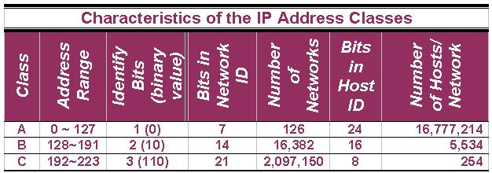
Class B IP Addresses (Cont.)
So how many Class B Networks can there be?
Using our formula, (2¹⁴ – 2), there can be 16,382 Class B Networks & each Network can have (2¹⁶ – 2) Hosts, or 65,534 Hosts.

Slide 31
Special Addresses
A few addresses are set aside for specific purposes.
Network addresses that are all binary zeros, all binary ones & Network addresses beginning with 127 are special Network addresses.

Slide 32
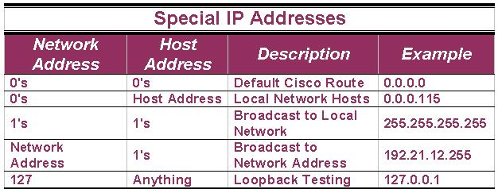
Special Addresses (Cont.)

Slide 33
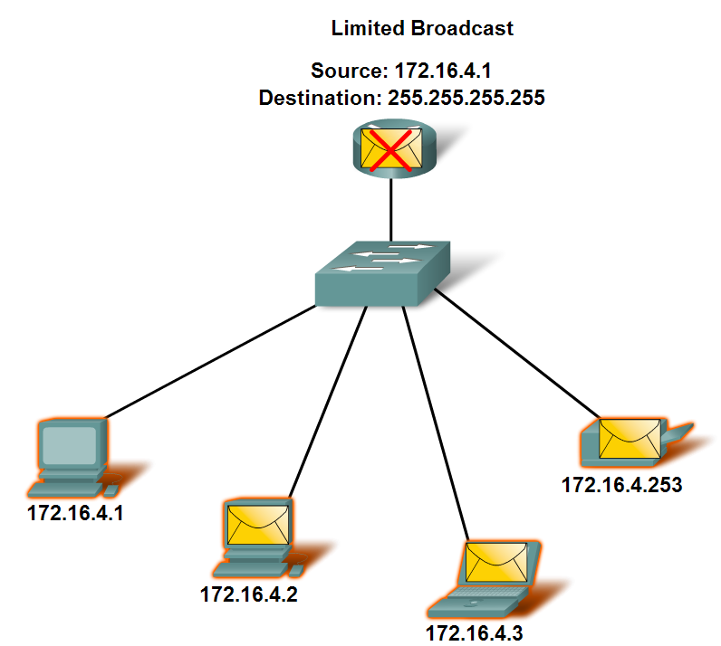
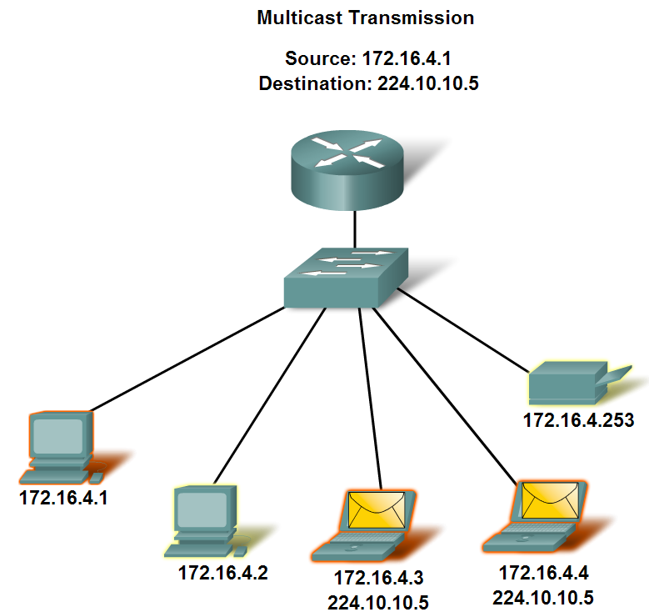
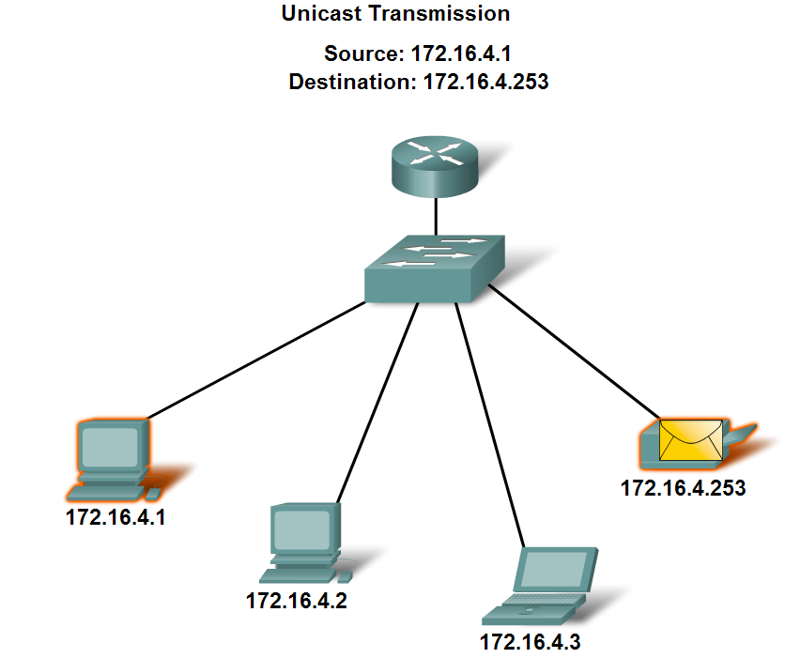
Classify and Define IPv4 Addresses

Slide 34
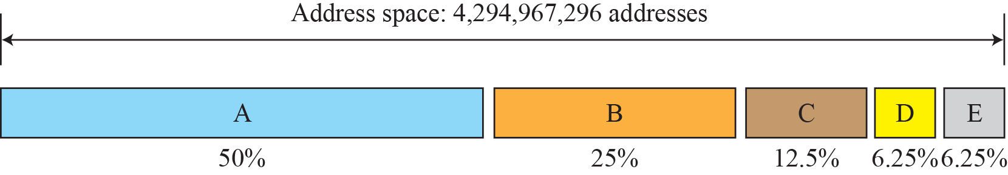
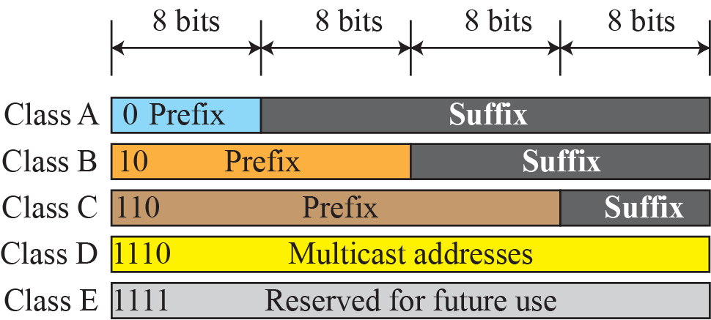
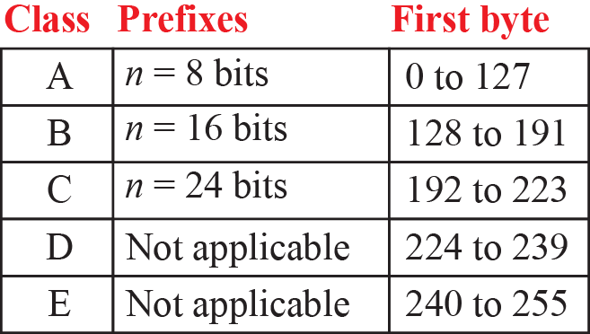
Figure 18.18: Occupation of the address space in classful addressing

Slide 35
Note
In classful addressing, a large part of the available addresses were wasted.
Internet Corporation for Assigned Names & Address (ICANN)

Slide 36
Mask can help us to find the netid and the hostid. (32 bit of contiguous 1 & 0’s)
Default masks for classful addressing
/n notation – Classless Addressing (Classless Interdomain routing)

Slide 37
Subnetting
Say Divide Large Block of Class A & B
Several contiguous groups
Assign Each group to smaller networks
Subnets
Introduced in Classful addressing
Increases the number of 1s in mask
Ex : Class A network divided into 4 subnets. Prefix Length n_{sub} = 10

Slide 38
Supernetting
Time came when A & B depleted ☹
Demand for mid-size blocks
But not meet requirements
Say 1000 address
4 Class C blocks to create one supernetwork
Classless eliminated need to supernetting

Slide 39
Note
Classful addressing, which is almost obsolete, is replaced with classless addressing.

Slide 40
Classless Addressing
Overcome Address Depletion
No concept of classes
Address granted in blocks retained (variable length prefix)
Depending on Requirement
Classful is special case of Classless addressing

Slide 41
Note
In IPv4 addressing, a block of addresses can be defined as
x.y.z.t /n
in which x.y.z.t defines one of the addresses and the /n defines the mask.

Slide 42
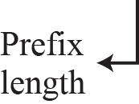
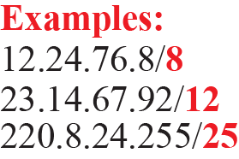
Figure 18.20: Slash notation (CIDR)

Slide 43
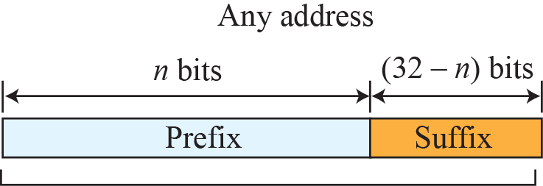
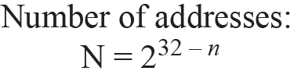
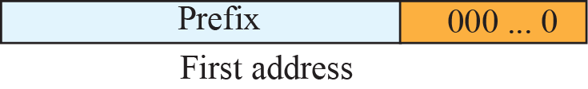
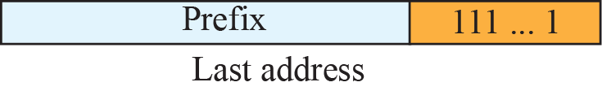
Figure 18.21: Information extraction in classless addressing
Set all suffix bits
to 0s
Set all suffix bits
to 1s

Slide 44
Note
The first address in the block can be found by setting the rightmost 32 − n bits to 0s.

Slide 45
Note
The last address in the block can be found by setting the rightmost 32 − n bits to 1s.

Slide 46
Note
The number of addresses in the block can be found by using the formula 2^{32−n}.

Slide 47
Example 18.1
A classless address is given as 167.199.170.82/27. We can find the above three pieces of information as follows. The number of addresses in the network is 2^{32− n} = 2⁵ = 32 addresses. The first address can be found by keeping the first 27 bits and changing the rest of the bits to 0s.
The last address can be found by keeping the first 27 bits and changing the rest of the bits to 1s.
18.47

Slide 48
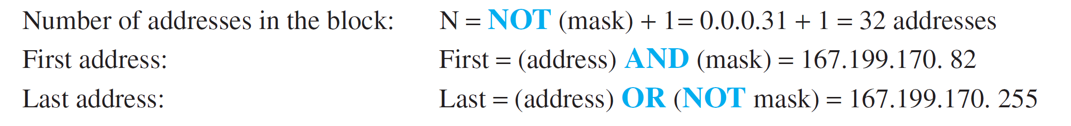
Example 18.2
Alternate way to find the same for 167.199.170.82/27 using the mask. The mask in dotted-decimal notation is 256.256.256.224 The AND, OR, and NOT operations can be applied to individual bytes
18.48

Slide 49
Classless Address Blocks Allocation
The addresses in block must be contiguous, one after another.
2. The number of requested addresses (N) in a block must be a power of 2.
N=2^{32-n} (or)
n = 32 – log₂N
3. The first address must be evenly divisible by the number of addresses.

Slide 50
Example 19.6
A block of 16 addresses is granted to a small organization. We know that one of the addresses is 205.16.37.39/28. What is the first address in the block?
Solution
The binary representation of the given address is
11001101 00010000 00100101 00100111
If we set 32−28 rightmost bits to 0, we get
11001101 00010000 00100101 0010000
or 205.16.37.32.

Slide 51
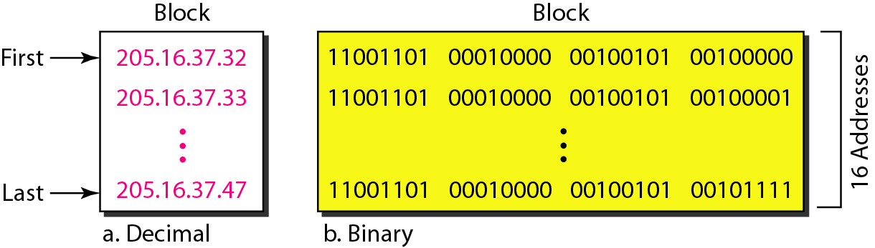
A block of 16 addresses granted to a small organization
Say one of the addresses is 205.16.37.39/28

Slide 52
Example 19.5
We can see that the restrictions are applied to this block. The addresses are contiguous.
The number of addresses is a power of 2 (16 = 2⁴), and the first address is divisible by 16.
The first address, when converted to a decimal number, is 1,720,193,680 , which when divided by 16 results in 107,512,105

Slide 53
Example 19.7
Find the last address for the block
Solution
The binary representation of the given address is
11001101 00010000 00100101 00100111
If we set 32 − 28 rightmost bits to 1, we get
11001101 00010000 00100101 00101111
or
205.16.37.47

Slide 54
Example 19.8
Find the number of addresses
Solution
The value of n is 28, which means that number of addresses is 2 ³²⁻²⁸ or 16.

Slide 55
Example 19.9
Another way to find the first address, the last address, and the number of addresses is to represent the mask as a 32-bit binary (or 8-digit hexadecimal) number. This is particularly useful when we are writing a program to find these pieces of information. the /28 can be represented as
11111111 11111111 11111111 11110000
(twenty-eight 1s and four 0s).
Find
a. The first address
b. The last address
c. The number of addresses.

Slide 56
Example 19.9 (continued)
Solution
a. The first address can be found by ANDing the given addresses with the mask. ANDing here is done bit by bit. The result of ANDing 2 bits is 1 if both bits are 1s; the result is 0 otherwise.

Slide 57
Example 19.9 (continued)
b. The last address can be found by ORing the given addresses with the complement of the mask. ORing here is done bit by bit. The result of ORing 2 bits is 0 if both bits are 0s; the result is 1 otherwise. The complement of a number is found by changing each 1 to 0 and each 0 to 1.

Slide 58
Example 19.9 (continued)
c. The number of addresses can be found by complementing the mask, interpreting it as a decimal number, and adding 1 to it.

Slide 59
Note
The first address in a block is normally not assigned to any device; it is used as the network address that represents the organization to the rest of the world.

Slide 60
Figure 19.4 A network configuration for the block 205.16.37.32/28

Slide 61
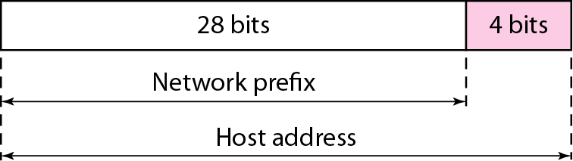

Slide 62
